Slide 1
Introduction to Corporate Governance
Mwamba Ally Jingu: FCPA; PhD

Slide 2
Characteristics of a Corporation
—It is a voluntary association of persons formed for a purpose of business for profit. The persons forming a corporation are referred to as its shareholders or, its owners.
—It has a common capital, divisible in to transferable shares, and possessing a corporate legal entity and a common seal.
—It is an artificial person; it is invisible and intangible.
—It is distinct from it owners, i.e., the shareholders
—Shareholders are not responsible for the acts of the co.
—It has the right to sue, and can be sued in its own name.
—It can own property, and operate an account in its own name

Slide 3
—It can do business like any natural person. It can own money and it can be a creditor or a debtor.
—It has a perpetual succession. This means that its life is not affected by the life of its members.
—Since it has no physical personality, it must function through natural persons, such as, directors.
—Shareholders, do not carry on business of a company.
—Companies are classified into 3 types: Companies limited by shares; limited by guarantee and unlimited companies.
—Moreover, companies may be classified into two types: public companies and private companies

Slide 4
CORPORATE STRUCTURE
―A typical corporation's structure consists of three main groups: Shareholders, directors and management.
―The management handle the day-to-day operations of the business,
―The directors oversee the affairs of the organization and protect the interests of the shareholders, while the shareholders are looking for a return on their investment.
―There are several types of corporate structure that are adopted around the world: One of such structures is illustrated in figure 1

Slide 5
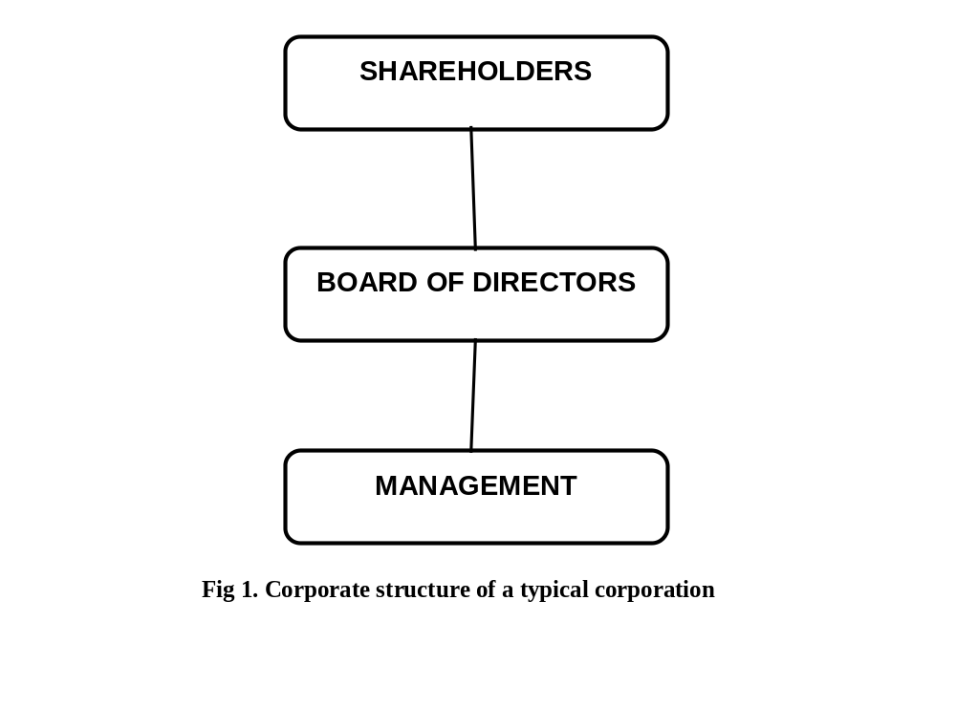

Slide 6
Shareholders
Audit Committee
Board of Directors
Remuneration Committee
Nomination Committee
Chief Executive Officer
Chief Finance Officer
Chief Operations Officer
Company Secretary
Fig 1. Corporate Structure

Slide 7
Corporate Structure: Shareholders
—A corporation's shareholders have an ownership interest in the company by having money invested in the corporation.
—Usually, each shareholder receives a share certificate from the corporation, identifying the number of shares held by him.
—In smaller corporations these initial investors may remain the sole shareholders throughout the corporation's existence.
—A smaller corporation's few shareholders may consist of those involved in day-to-day business
—Corporations are required by law to hold Annual General Meetings (AGMs),
—A corporation's articles of incorporation usually set forth shareholder voting rights and procedures.

Slide 8
Corporate Structure: Shareholder Structure continued
―Shareholder Structure also provides the records of types of shares issued by the company with the number of shares and the percentage of shareholding of each of the shareholders at given point of time.
―There are two main types of shares: Ordinary shares and Preference shares.
―There are two categories of preference shares: Non-cumulative preference shares and cumulative preference shares.
―The structure also indicates the voting rights of every shareholder with the shares held by him or her. This depends on the percentage of shareholdings and the class of share.
―Maintaining the Shareholding Structure of a Company helps the management to diversify the ownership of a company and not letting a group control or having exclusive decision power

Slide 9
Corporate Structure: Board of Directors
―Every company is required to be headed by an effective board to offer strategic guidance, lead and control the company and be accountable to its shareholders
―Usually, directors are identified in the "articles of incorporation" and/or "bylaws" of the corporation,
―But sometimes directors are selected by the person who takes the initial step of incorporating the business (sometimes called the "incorporator").
―Once the corporation is running, directors are typically elected by shareholders at annual General Meetings (AGMs).
―As suggested by its name, the board of directors "directs" the corporation's affairs and business path.

Slide 10
Corporate Structure: BOD Structure continued
The board of directors also has ultimate legal responsibility for the actions of the corporation management.
The number of directors serving on a BOD usually depends in part on the size of the business and its holdings,
however the number of directors is usually stated in the corporation's articles of incorporation and/or bylaws.
A small corporation might have two directors, while a large corporation may have more than 10 directors.
For voting purposes, a corporation should keep an odd number (3, 5, 7, 9, 11 etc.) of directors on its board.

Slide 11
Definitions of Directors
―Executive Director - means a director who is involved in the administrative or managerial operations of the company.
―Non-Executive Director (NED) - means a director who is not involved in the administrative or managerial operations of the company.
―A NED may not always be an independent director
―The NEDs who are not independent of the corporate management are also referred to as grey directors

Slide 12
Definitions of Directors Continued
―Members’ independence is usually defined as the absence of relationship with the company that may interfere with the exercise of their independence from management and the company.
―There are three main categories of relationships that have been identified by the regulatory literature:
employment;
(ii) personal; and
(iii) business relationships

Slide 13
Independent Director - means a director who:
(a) has not been employed by the company in an executive capacity within the last five years;
(b) within the last five years, has not had any business relationship with the company (other than service as a director)
(c) has no personal service contract(s) with the company, or a member of the company’s senior management;
(d) is not employed by a public company at which an executive officer of the company serves as a director;
(e) is not a member of the immediate family of any person described above;
(f) has not had any of the relationships described above with any affiliate of the company

Slide 14
The benefits of having one or more independent directors
they bring an objective viewpoint to the board
they are unlikely to have any family or majority ownership ties to the business
they can cast a critical eye over the business without prejudice
they bring a one-off business knowledge and experience in many areas
many start-ups and high growth businesses tend to operate in a vacuum without looking at outside forces
outside directors introduce a fresh, and usually innovative, perspective
they may compensate in some of the key areas where management may be weak
the outside director may act a bit like a consultant

Slide 15
Board Balance
The board should compose of a balance of:
― Executive directors* and non-executive directors including
― At least one third independent non-executive directors of diverse skills or expertise.
― It should also be gender sensitive.
This will ensure that no individual or small group of individuals can dominate boards decision-making processes
See the definitions in the next slide.

Slide 16
Board balance - number of individual directors
―The board should compose of a balance of executive directors and non-executive directors (including at least one third independent non-executive directors)
Thus a board of 8 members should consist of 4 executive directors and 4 non-executive directors
―In addition, the board should consist of at least one third independent directors.
Thus for a board of 8 members, the independent directors should be at least one third of 8, that is at least 3. More examples are shown in Table 1

Slide 17
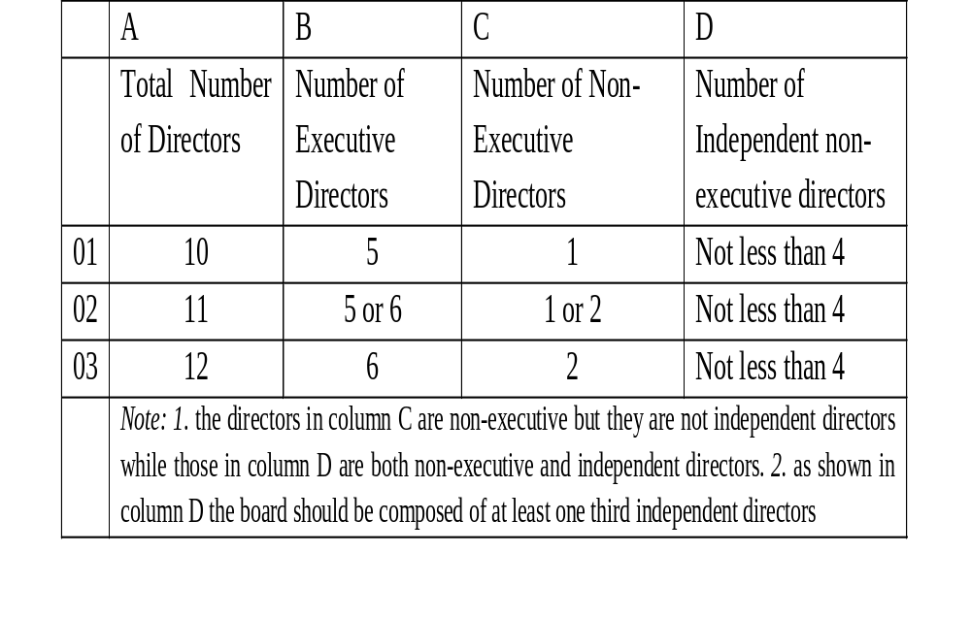
Table 1: A balanced board of directors

Slide 18
Board balance in terms of diverse skills or expertise of directors
―To be effective the board should be diversified in terms of skills and expertise of members.
―Example of skills include: Banking, Finance, Accounting, Human Resources, Marketing, Legal, Information Technology and other skills relevant to the industry.
―A board consisting of four members should consist of four skills and not one or two skills. Similarly, a board of 8 members should consist of at least 6 members of skills.
―A board of narrow skills needs to be recomposed

Slide 19
The Board and Board Committees
(i) The Board should establish relevant committees and delegate specific mandates to such committees as may be necessary.
(ii) The Board shall specifically establish an audit and nominating committee.
Multiple Directorship
No person shall hold more than three directorships in any public listed company at any one time;

Slide 20
Role of Chairman and Chief Executive
―There should be a clear separation of the role and responsibilities of the chairman and Chief Executive Officer (CEO)
―Such a separation will ensure a balance of power of authority and provide for checks and balances such that no one individual has unaffected powers of decision- making.
―However, Where such roles are combined a rationale for the same should be disclosed and approved by the shareholders

Slide 21
Audit Committee of the Board
The Audit Committees
―The board shall establish an audit committee of at least three independent and non-executive directors. The chairperson of the AC should be an independent or non-executive director
―The audit committee shall report to the board, with written terms of reference, which deal clearly with its authority and duties.
The duties and responsibilities of the audit committee will include inter alia (among others) the following:
The board should disclose in its annual report whether it has an audit committee and the mandate of such committee.

Slide 22
The Relationship between Shareholders and Managers (The Agency Relationship)
The Agency Theory is one of the prominent theories that have been used to explain corporate governance practices
This theory has established that as a corporation becomes so large its ownership and control are separated.
The shareholders own the corporation while the managers control the corporation. Corporate managers are thus seen to act as an agent for the shareholders (i.e., owners).

Slide 23
Two problems related to the management process as a result of the separation of ownership and control.
First, the goals of the owners and those of the managers may not be aligned.
The managers (agents) may use the firm’s assets for their own benefits at the expense of the owners (principals).
On the other hand the owners are assumed to be only looking for the financial returns they can get in relation to their investments.

Slide 24
The second problem relates to the difficulties the owner may face in observing an agent’s actions due to inadequate information they get about the business.
In contrast the managers have substantial and significant information of the firm than the owners. This is referred to as an information asymmetry.
The two problems are known as agency problems (the principal- agent problem).
Agency Theory is concerned with aligning the interests of the principals (e.g. shareholders) and agents (e.g. Managers)

